Slide 1
Pharmacy Quality Improvement Initiative Kick Off May 20, 2021
Care Transformation Collaborative of R.I.

Slide 2
Zoom
Welcome! Please Chat in:
- Your Name and Organization
Please mute yourself when not speaking
Please use the ‘Raise Hand’ feature

Slide 3
Agenda:
Welcome & Introductions (Susanne Campbell)
PQI Framework & Performance Reports (Steve Kogut)
Practice Facilitation Background (Kelley Sanzen)
Mini Z Survey
Review of Milestone Document (Susanne Campbell)
Patient Voice & Needs (Maureen Maigret)

Slide 4
Pharmacy QI Committee
Susanne Campbell, Care Transformation Collaborative of RI
Pano Yeracaris, Care Transformation Collaborative of RI
Jazmine Mercado, Care Transformation Collaborative of RI
Stephanie De Abreu, Unitedhealthcare
Stephen Kogut, University of Rhode Island
Deborah Newell, Rhode Island Department of Health
Megan Fallon-Sheridan, Rhode Island Department of Health
Maureen Maigret, RI Long Term Care Coordinating Council
Neil Sarkar, Rhode Island Quality Institute

Slide 5
Participating Teams:
1. Anchor Medical Associates
2. Coastal Medical- East Greenwich
3. Providence Community Health Center- Capitol
4. Rhode Island Primary Care Physicians
5. Women’s Medicine Collaborative
6. Thundermist Health Center
7. Medical Associates of RI

Slide 6
PQI Framework & Performance Reports
Stephen Kogut PhD, MBA RPh

Slide 7
Prevention Quality Indicators (PQI): Background
“The PQIs provide a good starting point for assessing the quality of preventive care in the community.”
“…provide information on admissions for ambulatory care sensitive conditions that evidence suggests could have been avoided, at least in part, through better outpatient care.”
AHRQ Quality Indicators—Guide to Prevention Quality Indicators: Hospital Admission for Ambulatory Care Sensitive Conditions. Rockville, MD: Agency for Healthcare Research and Quality, 2001. AHRQ Pub. No. 02-R0203. www.qualityindicators.ahrq.gov

Slide 8
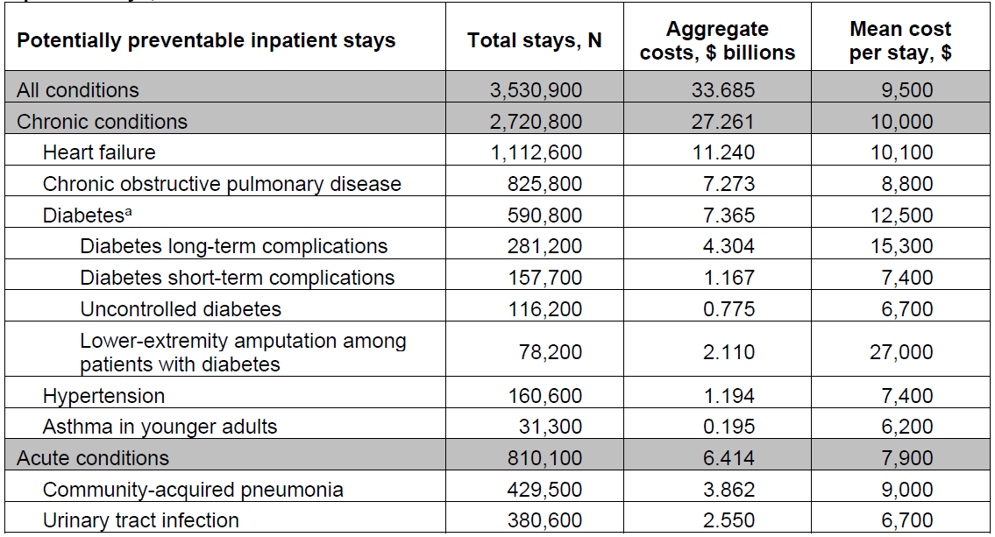
US total stays, aggregate costs, and mean cost per stay for potentially preventable adult inpatient stays, 2017
McDermott KW (IBM Watson Health), Jiang HJ (AHRQ). Characteristics and Costs of Potentially Preventable Inpatient Stays, 2017. HCUP Statistical Brief #259. June 2020. Agency for Healthcare Research and Quality, Rockville, MD.

Slide 9
Adapting the PQI Measures for this QI Project
Include Emergency Department visits
Outcome: condition-specific denominators
Numerator: Primary diagnosis
Data Source: HealthFacts RI 2019 (APCD)
Includes most private insurance
Medicaid
Medicare Advantage
Measure composites
Exclusions

Slide 10
Measure Exclusions
Global
In nursing home
Under age 18
Heart Failure / HTN
Cardiac procedures
Diabetes
n/a
COPD / Asthma
Cystic fibrosis
Anomalies of the respiratory system
CAP
Sickle cell anemia
Immunocompromised
UTI
Kidney/urinary tract disorder

Slide 11
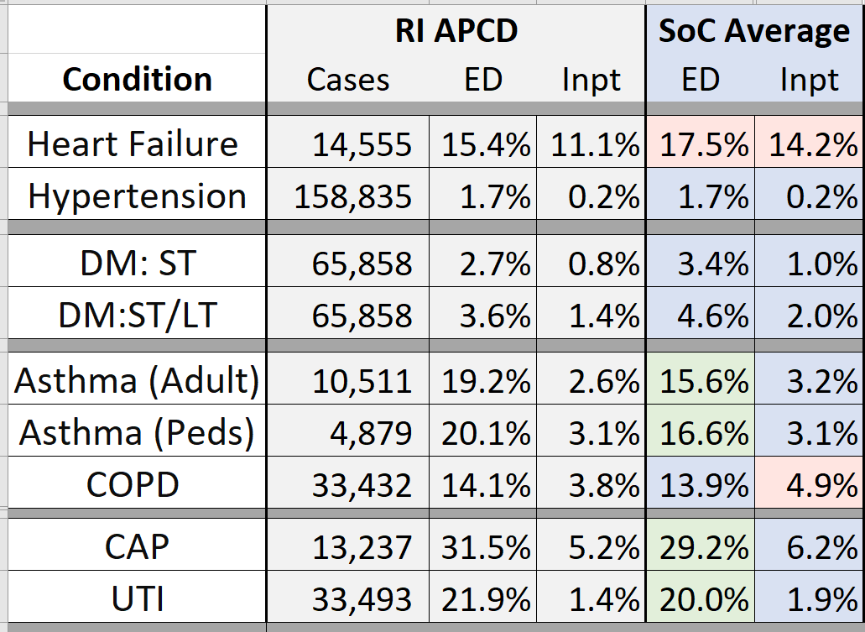
Results: Overall v Systems of Care
Definitions:
ED: Percent of cases with ≥ 1 ED visit
Inpt: Percent of cases with ≥ 1 inpatient stay
DM:ST is short term complications of diabetes
DM:ST/LT is short or long-term complications
SoC Average (in blue) is the mean rate across Anchor, Coastal, MARI, RIPCPC & Thundermist
Green shade: > 1 point lower than RI APCD rate
Red shade: > 1 point higher than RI APCD rate
Cells are empty where values could permit determining numerator < 11 cases

Slide 12
Results: Overall v Women & Higher Poverty Zip Code
Central Falls, Woonsocket, Providence, Pawtucket, Burrillville, more

Slide 13
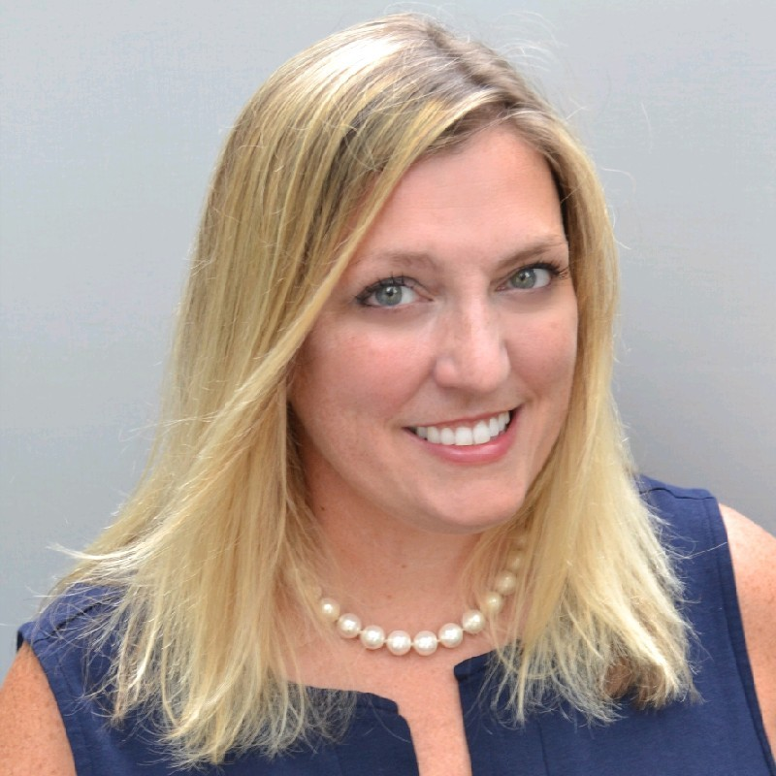
Practice Facilitation
Kelley Doherty Sanzen, PAHM, CDOE

Slide 14
Practice Facilitator Role
Monthly meetings to discuss project plan and program development strategy
Facilitate care team well-being survey
PDSA facilitation
Consult with practices to develop AIM statements and set SMART goals
Evaluate existing workflows and opportunities for improvement of team-based care
Select outcomes measures in conjunction with practices
Assist practice in developing patient engagement strategy
Identify at risk populations and implement risk stratification methods into workflows to optimize team-based care and provider well being
Assist practices with action plan development and execution
Report practice performance and goal attainment through monthly progress reports to CTC-RI

Slide 15
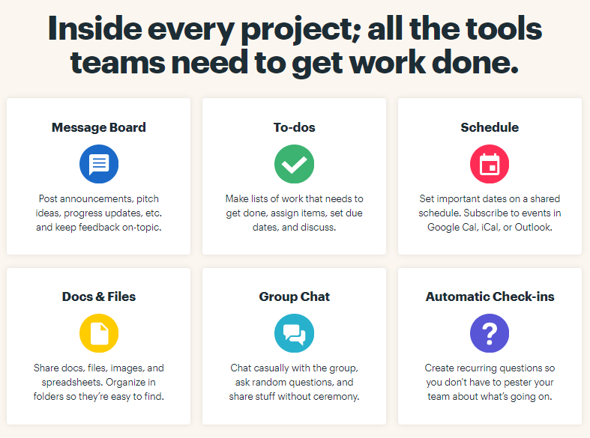
Introduction to Basecamp
Basecamp is more than just a project management tool — it’s a better way to work. Teams that switch to Basecamp are more productive and better organized.
Get organized and stay that way with Basecamp projects
A notification email will be sent to all team members today.
Pharmacy QI Resources can be found on our basecamp project folder.

Slide 16
Questions & Discussion

Slide 17
Patient Engagement
Maureen Maigret, RN, BS, MPA

Slide 18
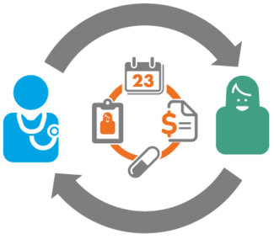
Why Patient and Family Engagement
For Patients/Consumers
Engagement Patient Activation
Improved Care Outcomes
Patient self-management of chronic diseases
Reduced Costs
Patient/Family Education Tools Handouts Teach Back Mail: electronic and snail Patient portals – Highly accepted Webinars
Promotes Shared Decision Making
Identify What Matters to Patient
Understanding patient’s cultural background and preferences is Important
For Family Caregivers/Advocates
In RI, 136,000 unpaid family caregivers providing 100 Million hours care (AARP)
Supporting them is critical
Involving family members in decisions (with patient consent) and providing support and education drives positive experience
Several Laws require identifying family caregivers and assessing their needs
CARES Caregiver Advise, Record, Enable) Act – Hospitals must record if family caregiver is involved and need to be provided education on any nursing tasks they may be responsible for upon discharge home
For persons on Medicaid Home Care, if family helping with care, they must be assessed for needs and provided with resource information and education
Know what support programs available, esp. for carers of persons with Alzheimer’s/other dementias. Alzheimer’s virtual support groups; AARP programs TCI provides up to 4 weeks partial paid leave
“The presence of a family member who will act as a fearless advocate is not just essential—it is a matter of survival.”
from: "Passages in Caregiving: Turning Chaos Into Confidence," by Gail Sheehy

Slide 19
Many Levels of Patient+Family Engagement
RI Examples of Organizational Design
Provider Satisfaction Surveys
Medicaid Consumer Advisory Committees; Medicaid Client Surveys
AE Consumer Advisory Panels
Examples of Policy making
Legislative Hearings
Focus groups
No Wrong Door Alzheimer’s State Plan
Patient Engagement, " Health Affairs Health Policy Brief, February 14, 2013.DOI: 10.1377/hpb20130214.898775

Slide 20
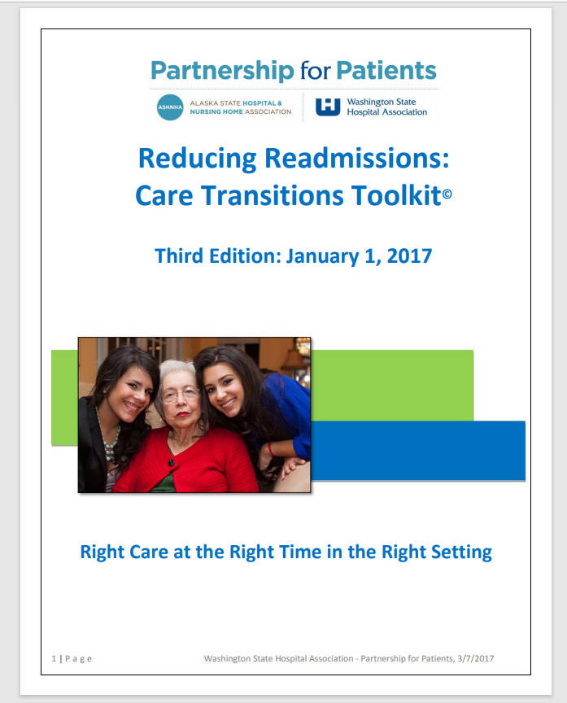
Pre-discharge Coordination
As part of discharge planning, find out what patient is going back to and their needs. Will they need Home Care follow-up? Do they live alone (as do 34% older RIers )? Do they understand what are warning signs? Do they have family/friends who can help in pinch? Do they have food in home or know how to get some? Know about the POINT (462-4444) for referral to community resources such as BE KIND RI for food delivery, PROJECT HELLO for friendly weekly call by vetted volunteer, digiAGE for digital education and technology needs and for accessing benefits for which they may be eligible.
11. Follow-up Appointment - Primary Care Visit

Slide 21
Post-Hospital Syndrome
Nearly one-fifth Medicare patients discharged from a hospital develop an acute medical problem within 30 days and need readmission
Many for reasons which have little in common with initial Dx.
Post-Hospital Syndrome-A Condition of Generalized Risk. https://www.ncbi.nlm.nih.gov/entrez/eutils/elink.fcgi?dbfrom=pubmed&retmode=ref&cmd=prlinks&id=23301730

Slide 22
USEFUL RESOURCE: ASSESSING THE 8P’s

Slide 23
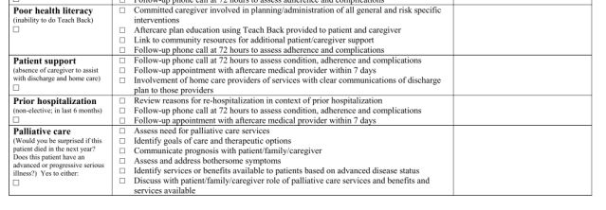
* P’s Checklist Assessment Continued

Slide 24
MORE USEFUL RESOURCES
The IDEAL Discharge Planning strategy highlights the key elements of engaging the patient and family in discharge planning:
Include the patient and family as full partners in the discharge planning process
Discuss with the patient and family five key areas to prevent problems at home:
1. Describe what life at home will be like
2. Review medications
3. Highlight warning signs and problems
4. Explain test results
5. Make follow-up appointments
Educate the patient and family in plain language about the patient’s condition, the discharge process, and next steps at every opportunity throughout the hospital stay
Assess how well doctors and nurses explain the diagnosis, condition, and next steps in the patient’s care to the patient and family and use teach back.
Listen to and honor the patient and family’s goals, preferences, observations, and concerns.
* Source::Care Transitions from Hospital to Home: IDEAL Discharge Planning Implementation Handbook @ https://www.ahrq.gov/patient-safety/patients-families/engagingfamilies/strategy4/index.html
Importance of Patient Engagement https://www.colleaga.org/article/importance-patient-engagement

