Slide 1
Agenda
Topic Presenter(s) | Duration
Welcome Remarks Deborah Garneau, RIDOH | 5 minutes
CTC and Practice Introductions All | 20 minutes
Woman and Infants Teleconsultation Overview and Screening Presentation Margaret Howard, WIH | 35 minutes
Question and Answer Period All | 10 minutes
CTC Milestone Review Susanne Campbell, CTC | 10 minutes
Measurement Evaluation Discussion Jim Beasley, RIDOH | 10 minutes

Slide 2
Welcome
Practices
Medical Group, Primary Care & Specialty Services: Family Care Center
Obstetrics and Gynecology Associates
Women & Infants Health Care Alliance - Women’s Care, Inc.
Division of Maternal-Fetal Medicine
Division of Obstetric & Consultative Medicine

Slide 3
Statewide initiative modeled after PediPRN & funded by HRSA
Focused on practices/providers seeing pregnant/postpartum women
The goal is to help providers screen and manage perinatal depression, anxiety, and/or substance use by offering access to 1) perinatal behavioral health teleconsultation line (WIH) and 2) virtual practice advisement and support services (CTC-RI)

Slide 4
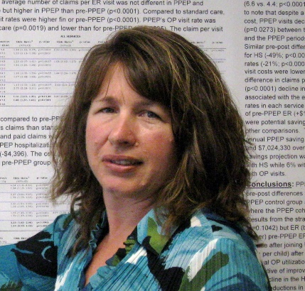
RIDOH Team and Supports
Deb Garneau, MA Jennifer Levy, MD Jordan White, MD Jim Beasley, MPA Monika Drogosz, MPH
MCH/Project Director Consultant Medical Director Consultant Medical Director Program Manager Program Evaluator
Evaluation and programmatic assistance
Maternal and child health policy and clinical expertise
Connections to statewide maternal/child health clinical programs/iniatives
RI Task Force to Support Pregnant and Parenting Families with Substance-Exposed Newborns
RIDOH Title X Family Planning Supports & RIghtTime app

Slide 5
Overview of CTC Care Transformation Collaborative of R.I.
[Ri momsprn cohort 2 kick-off] [February 23, 2021]
Sign up for our newsletters: Monthly Newsletters | CTC-RI (ctc-ri.org)
Our Website: ctc-ri.org

Slide 6
What is CTC?
CTC works with key stakeholders who select, test and evaluate innovative clinical strategies to build the capacity of the RI primary care team to meet the needs of families living in our communities – intended to result in better care, smarter spending and informed public policy
Growing impact across RI:
About 695,000 Rhode Islanders receive care from one of our practices
About 800 providers across our adult and pediatric practices
Worked with 58 providers at 4 pre-natal practices in the RI MomsPRN Program, Cohort 1

Slide 7
CTC Team
Oversight of QI Activities:
Susanne Campbell, RN, MS, PCMH CCE
Senior Project Director
Pano Yeracaris, MD, MPH
Chief Clinical Strategist
Evaluation & Program Coordination:
Carolyn Karner, MBA
Program Coordinator and Data Analyst
Jade Arruda, BS
Program Administrator

Slide 8
CTC Practice Facilitators
Vicki Crowningshield, MPH, PCMH CCE
PF: LPG OBGYN, WIH Center for Ob and Consultative Medicine
Suzanne Herzberg, PhD, MS, OTR/L
PF: BVCHC, CNE Women’s Care, CNE-MG Family Care Center, RIHB & Hope Family Health, Tri-County, VICTA
Jody Vieira, LICSW
PF: Center for Ob & Gyn, WIH MFM

Slide 9
Meet The Practices
1. Blackstone Valley Community Health Care – Pawtucket | Kelsey Okolowitcz
2. Center for Obstetrics & Gynecology - Providence
3. CNE Women’s Care - Providence | Abby Wetzel
4. CNE-MG Family Care Center - Pawtucket | Deb Moorhead
5. LPG OBGYN Associates - Providence | Meghan Sharp
6. RI Home Birth & Hope Family Health - Hope | Mary Schwartz Mumford
7. Tri- County Community Action Agency - Johnston | Jennifer Caffrey
8. VICTA - Providence | Lisa Peterson
9. W&I Maternal Fetal Medicine - Providence | Martha Kole-White
10. WIH Center for Obstetric and Consultative Medicine - Providence | Kenneth Chen
What does your practice hope to get out of the RI MomsPRN Program?

Slide 10
Screening for Depression, Anxiety and Substance Use in the Perinatal Period
Margaret Howard, PhD
Professor of Psychiatry & Human Behavior and Medicine, Clinician Educator
Division Director, Women’s Behavioral Health

Slide 11
Funding and Disclosures
Sage Therapeutics Advisory Board
HRSA UK3MC32244-01-00

Slide 12
Acknowledgements
Rhode Island Dept. of Health
Women & Infants Hospital
Zobeida Diaz, MD
Cynthia Battle, PhD
Eva Ray, LCSW
Jordan White, MD
Jennifer Levy, MD
Deb Garneau, MA
Jim Beasley, MPA
Monika Drogosz, MPH
Christopher Breault, MA

Slide 13
Why do we care about Women’s Mental Health?
“Depression is the leading cause of lost years of healthy life among women.”
Active maternal mental illness carries risks to the mother, fetus, and infant

Slide 14
Perinatal Depression and Anxiety
COMMON
Prevalence: 15% - 21% (all PMADs)
The most common, unrecognized complication of the perinatal period
MORBID
Devastating consequences for women, infants and families:
Poor maternal nutrition
Missed prenatal appointments
Low birth weight
Preterm birth
TREATABLE
Byrnes (2019) Arch Psych Nursing
Davalos et al (2012) Arch Women Ment Health 15:1-14
Gavin et al (2005) Obstetrics & Gynecology:
Gaynes et al (2005) AHRQ Systematic Review;
Grigoriadis S et al (2017)Canad Medic Assoc J 189(34)

Slide 15
Risk Factors
Women with:
Prior history of PPD or MDD
Family History
Depression during Pregnancy*
Intimate Partner Violence
Absence of support
Primary relationship distress
Single parenthood
Current or historical stressful life events (poverty, trauma, death in family)
Young Age
Pregnancy or delivery complications
English et al (2018) Scientific Reports; Lancaster CA
Ghaedrahmati, M., et al. (2017) Journal of Education and Health Promotion
Koleva et al (2011) Arch Women’s Ment Health
Gavin et al. (2005) Obst & Gy
Gaynes et al. (2005) AHRQ Systematic Review

Slide 16
Perinatal Substance Use
ON THE RISE
Prevalence: up to 10% consume alcohol and 3% binge drink during pregnancy
2% report illicit opioid use
# of women with OUD at labor and delivery quadrupled from 1999 to 2014
MORBID
Impaired decision-making and parenting
Family more likely to become involved with legal and child welfare agencies
Risk of NAS/NOWS (Neonatal Abstinence Syndrome; Neonatal Opioid Withdrawal Syndrome)
TREATABLE
Ordean et al. (2017) Substance abuse: research and treatment
U.S. Center for Disease Control and Prevention (2018)

Slide 17
Screening: Gaining Traction
Over a 15-year period, there’s been a significant increase (7x) in screening for depression in obstetrical settings
Haight SC et al (2019) Obstet Gynecol 13 (6): 1216-1223.

Slide 18
Screening is Recommended!
)

Slide 19
Edinburgh Postnatal Depression Scale (EPDS)
The mother is asked to check the response that comes closest to how she has been feeling in the previous 7 days.
All the items must be completed.
The mother should complete the scale herself without discussing with others, unless she has difficulty with reading
Maximum score: 30
Possibly depressed: 13 or greater
Always look at item 10 (thoughts of self-harm/suicide)
Cox et al (1987). British Journal of Psychiatry 150:782-786

Slide 20
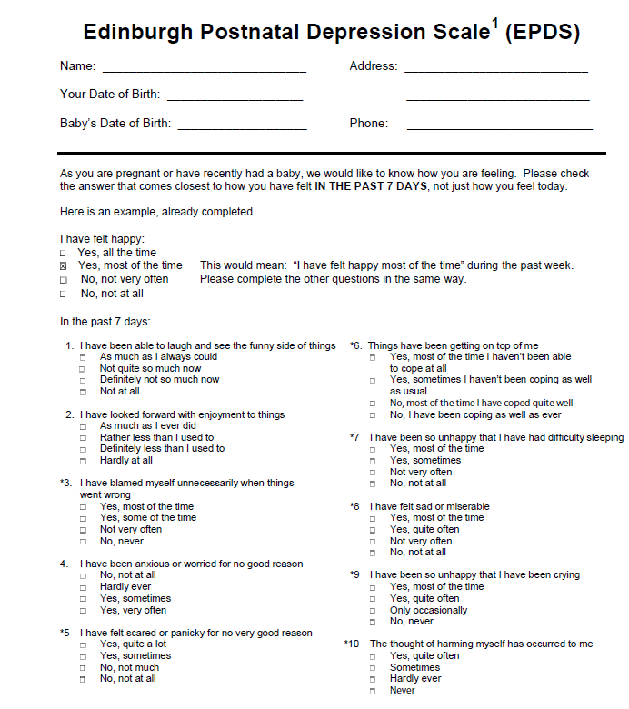

Slide 21
Patient Health Questionnaire-9 (PHQ-9)
The patient is asked to respond to each of the 9 items based on how they’ve been feeling over the last 2 weeks.
An additional question asks the patients to report – “How difficult have these problems made it for you to do your work, take care of things at home, or get along with other people?”
not used in calculating score but represents the patient‘s global impression of symptom-related impairment
may be useful in decisions regarding initiation of or adjustments to treatment
Maximum score: 27
Possibly depressed: 10 or greater
Always look at item 9 (thoughts of self-harm/suicide)
Kroenke K, Spitzer RL. Psychiatric Annals 2002;32:509-521.

Slide 22
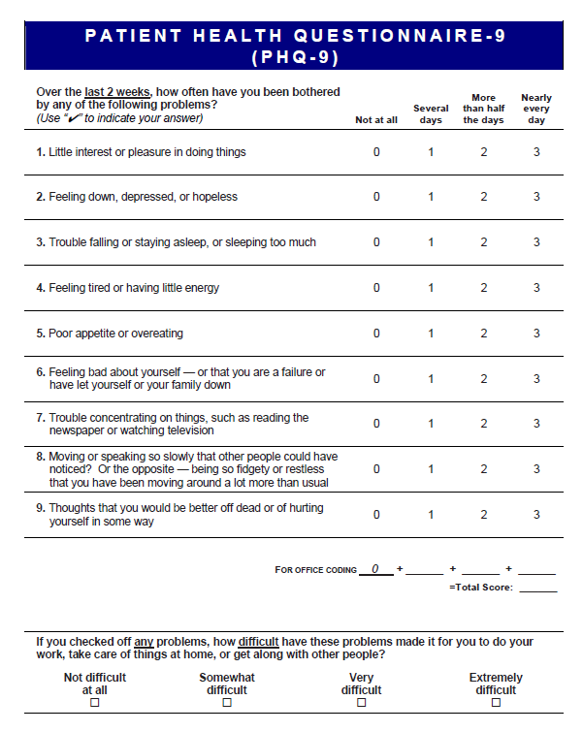

Slide 23
Generalized Anxiety Disorder – 7 (GAD-7)
The patient is asked to respond to each of the 7 items based on how they’ve been feeling over the last 2 weeks.
Designed primarily for Generalized Anxiety Disorder but can also indicate possible Panic Disorder, Social Anxiety Disorder or Post-traumatic Stress Disorder
Maximum score: 21
Possible anxiety: 7 or greater
Kroenke K, Spitzer RL. Psychiatric Annals 2002;32:509-521.

Slide 24
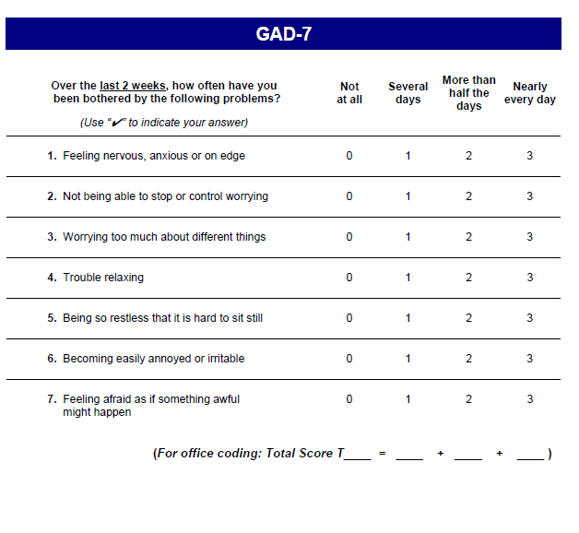

Slide 25
Alcohol Use Disorders Identification Test- Concise (AUDIT-C)
The patient is asked to answer the 3 questions about frequency of alcohol consumption, based on the last 12 months.
In perinatal women, a score of 3 or more is considered positive. However, when the points are ALL from Q1 alone (Q2 and Q3 are zero), it can be assumed that the patient is drinking below recommended limits and it is suggested that the provider review the patient’s alcohol intake in the last few months prior to pregnancy to confirm accuracy.
Maximum score: 12
Possible alcohol misuse: 3 or greater
Kroenke K, Spitzer RL. Psychiatric Annals 2002;32:509-521.

Slide 26
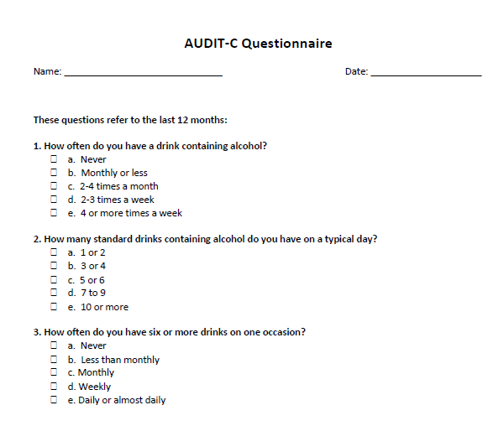

Slide 27
Drug Abuse Screening Test-10 (DAST-10)
The patient is asked to answer 10 YES/NO questions based on the past 12 months
“Drug abuse” refers to the use of prescribed or over-the-counter medications/drugs in excess of the directions AND any non-medical use of drugs
Questions do not include alcohol or tobacco.
Maximum score: 10
Possibly substance misuse: 1 or greater

Slide 28
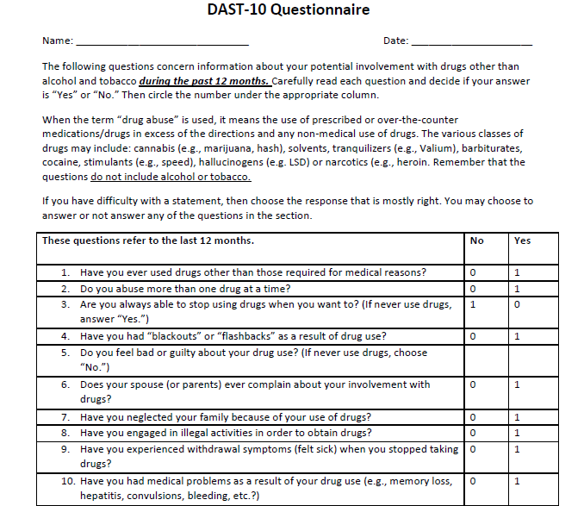

Slide 29
Screening: What to ask
How are YOU doing?
Are you feeling moodier than normal?
How is your sleep? Can you sleep when the baby sleeps?
Even though everyone expects this to be a happy time, many women who have just had a baby feel sad, nervous, irritable or just “not themselves”. Has this been your experience?
Dawson et al (2005) Alcoholism: Clinical and Experimental Research, 29(5), 844–854.
Bush et al (1998) Arch Internal Med 3: 1789-1795

Slide 30
Screening: What to look for
Tearfulness
Appearing unusually tired
Disheveled, poor hygiene
Poor eye contact
Irritability
Discomfort holding/handling the baby
Significant weight loss
Excessive concern about the baby despite reassurance
Dawson et al (2005) Alcoholism: Clinical and Experimental Research, 29(5), 844–854.
Bush et al (1998) Arch Internal Med 3: 1789-1795

Slide 31
Screening: Assessing Risk of Harm
Suicidal Ideation
LOWER RISK No Hx of Attempts No plan No intent No substance use Protective factors (i.e., social connections, spiritual/religious beliefs, meaningful employment)
Thoughts of Harming Baby
LOWER RISK Thoughts are intrusive and disturbing No psychotic symptoms Thoughts cause fear/anxiety Good insight
Adapted from MCPAP for Moms (2017).
Morriss et al(2013). BMJ: British Medical Journal, 347(7928), 33-35.

Slide 32
Positive Screen
Utilize established clinical protocols
Call RI MomsPRN: 401-430-2800
Initiate Treatment with RI MomsPRN consultation
Refer for ongoing BH treatment

Slide 33
RI MomsPRN Services
Resource and Referral Specialist (Social Worker) | Clinical Consultation (Psychiatrist & Psychologist) | Continuing Education
Call intake and triage Make connections to treatment and support services Schedule provider teleconsultation with perinatal behavioral health experts | Same day provider-to-provider teleconsultation services Diagnostic support Treatment planning Medication and dosage recommendations Advisement about prescription concerns | Deliver continuing medical education sessions on a variety of maternal behavioral health topics to various provider groups

Slide 34
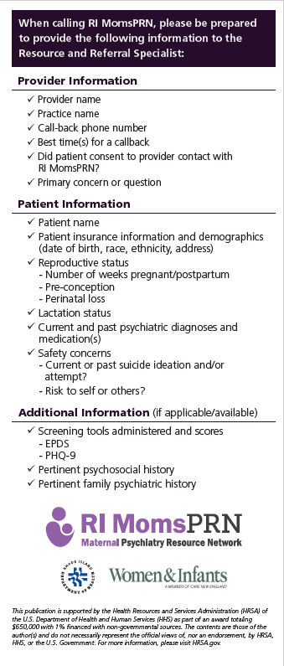

Slide 35
Thank You and Questions
401-430-2800
Mon – Fri, 8a.m.– 4p.m.
MHoward@wihri.org
ERay@wihri.org
RIMomsPRN@CareNE.org

Slide 36
Milestone Document Review
Susanne Campbell, ctc

Slide 38
Evaluation Matters
Practice- and Provider– Level Surveys
RIDOH (pre- and post-): Helps measure clinical self-efficacy improvements made over the cohort
HRSA (just once at end of 2021): Helps federal funder measure effectiveness of perinatal behavioral health support programs across the nation
No identifiable information will be reported with any survey
Providers are defined as those who clinically manage perinatal behavioral health (i.e. assess, refer, and treat). Exclude support staff just involved in one aspect (i.e. medical assistances)
Seeking ≥80% completion rates among practice providers for full practice payment

Slide 39
Evaluation Matters
Quarterly Screening Reports
CTC-RI and RIDOH will help practices setup protocols and systems to track the screening and positive identification of perinatal patients for depression, anxiety, and substance use disorder, with the goal that all perinatal patients are screened at least once for each domain during the performance period (4/1/21–3/31/22)
Practices will choose the validated screening instrument they will use and when they use it
Each quarter, practices will report de-identified counts of attributed perinatal patients, those screened for each domain, those screened positive within each domain, and patient zip
CTC-RI & RIDOH can provide de-duplication and reporting assistance

Slide 40
Evaluation Matters
Quarterly Screening Reports
Practices showing improvements with screening across all three domains from baseline will be eligible for full final practice payments
CTC-RI and RIDOH will be hosting a measure specification meeting to discuss this data collection in detail in March. A doodle poll will be forthcoming and please share with relevant staff to complete.
RIDOH is also offering practices additional data payments totaling $3,000 for those who are able and willing to provide supplemental demographic (age, race, ethnicity, insurance, and pregnancy status), treatment, and referral data with their quarterly screening reports. This is completely optional and separate from the $10,000 practices are already eligible to earn for completing various deliverables. Please let your CTC-RI practice facilitator know if your practice is interested.

