Slide 1
Billing for Groups and Connecting with and Paying for Psychiatry
Mary Jean Mork
July 12, 2018

Slide 2
Shared Medical Visits = Groups Visits

Slide 3
Billing and coding for Group Visits
Currently, there are no nationally accepted standards for coding and billing for group visits.
Several years ago the American Academy of Family Practitioners (AAFP) sought to clarify Medicare billing requirements and received the following response from the Western regional Medicare contractor:
“...under existing CPT codes and Medicare rules, a physician could furnish a medically necessary face-to-face E&M visit (CPT code 99213 or similar code depending on level of complexity) to a patient that is observed by other patients. From a payment perspective, there is no prohibition on group members observing while a physician provides a service to another beneficiary.”
American Academy of Family Physicians (AAFP). Coding for Group Visits. Retrieved on July 9, 2014 from http://www.aafp.org/practice-management/payment/coding/group-visits.html

Slide 4
Ways to bill for groups in primary care
Medical before or after behavioral portion of the group:
Behavioral health delivers group services - bills
Medical provider bills for the shared medical visit
For example: a 90 minute group may have a 99213 for the “shared medical visit” portion and 60 minutes for the 90853 behavioral group treatment
Medical “pull out” of group:
Medical provider “pulls out” patients throughout group session – bills for medical visit
Behavioral health bills for group, minus time away with provider
Medical provider bills for the group (and behavioral health doesn’t bill)
Ensure that payer allows two services on the same day

Slide 5
Example of Guidelines for “Shared Medical Appointments” (BC/BS of North Carolina)
Patient is an established patient in the practice
The group visit is disease or condition specific, but could include multiple chronic conditions
Patient attendance is completely voluntary, patients can also have individual appointments
Adequate group space is available
Appropriate staff are available to facilitate the group
Individual as well as group interaction is documented
From: Corporate Reimbursement Polices: Group visits (Shared Medical Appointment) Guidelines. Blue

Slide 6
Behavioral Health Group Billing - 90853
Can be an effective and efficient form of treatment for mental health issues.
Require that each patient have an Initial Psychiatric Assessment to determine the diagnosis
Treatment Plan is developed that includes the group as method of treatment
Each Group Treatment note includes a general statement about the group session and an additional paragraph specific to that patient’s involvement/progress in relation to that group session.
All other Progress Note expectations apply.

Slide 7
Common Billing Practice
•Document clearly – individual services provided to each patient as well as the services provided to the group as a whole
•Emphasize the medical management component
•Use medical E/M code 99213 (rarely 99214)
•If more than one clinician billing (i.e., a physician and psychologist) differentiate services provided to avoid duplicate billing
•Patient education is not directly reimbursed under current system, except in specific cases such as diabetes self management education (DSME) by a certified diabetes educator (CDE)
References:
Putting Group Visits into Practice in the Patient Centered Medical Home. Stephanie Eisenstat MD, Karen Carlson MD and Kathleen Ulman PhD. Massachusetts General Hospital 2014
Putting Group Visits into Practice: A Practical Overview to Preparation, Implementation and Maintenance of Group Visits at Massachusetts General Hospital. 2012, Eisenstat, Lipps Siegel, Carson and Ulman. 2012.

Slide 8
Recommended Next Steps
If setting up groups that include both medical provider and behavioral health clinician: Contact payers to determine if the behavioral portion of the group visit can be directly billed by the BHC
http://www.e-meds.com/how-code-grup-visit-or-shared-medical-appointment
Contact Medical Director of the Medicare carrier : Paul Hughes – 803-264-770
Paul.hughesmd@eds.com
Inform each insurer in advance of your intent to begin furnishing group visits and how you plan to bill for them. American College of Physicians.
https://www.acponline.org/practice-resources/business-resources/office-management

Slide 9
References for Group Visits
1. Shared Medical Appointments: A Recipe for Success (Cleveland Clinic)https://www.youtube.com/watch?v=9_4T-Z6tWNk
2.Group Visit Coding (American Academy of Family Physicians)
•http://www.aafp.org/practice-management/payment/coding/group-visits.html
3.Specific Payment Codes for the Federally Qualified Health Center Prospective Payment System (CMS)
• https://www.cms.gov/Medicare/Medicare-Fee-for-Service-Payment/FQHCPPS/Downloads/FQHC-PPS-Specific-Payment-Codes.pdf or search for FQHC PPS 4-26-16
4. Medicare Benefit Policy Manual , Chapter 13 - Rural Health Clinic (RHC) and Federally Qualified Health Center (FQHC) Services (CMS)
• https://www.cms.gov/Regulations-and-Guidance/Guidance/Manuals/Downloads/bp102c13.pdf or search for Medicare Benefit Policy Manual, Chapter 13, 1-15-16

Slide 10
Connecting with and Paying for Psychiatry
Notes:
Please insert the assigned session number (track letter, period number), i.e., A2a
Please insert the TITLE of your presentation.
List EACH PRESENTER who will ATTEND the CFHA Conference to make this presentation.
You may acknowledge other authors who are not attending the Conference in subsequent slides.

Slide 11
Comparison of Employment Arrangements for Co-located and Integrated Practice
Level of Collaboration | Psych covers all expenses | Practice offers space | Practice offers space and scheduling | Practice employs
Co-located Practice Level 3 and 4 | Psych bills Psych schedules Separate records Separate service | Psych bills Psych schedules Separate records Some communication with releases | Psych bills Separate records Streamlined referral and scheduling process Communication with releases | Practice bills Same record Shared responsibility for schedule Streamlined processes Communication without need for releases
Partially Integrated Level 5 |  |  | Psych bills Separate record Coordinated care Streamlined referral and scheduling process Releases part of routine Connected to primary care team | Practice bills Same record Shared responsibility Streamlined processes Improved coordination and communication Working toward becoming part of primary care team
Fully Integrated Level 6 |  |  |  | Practice bills Same record Shared responsibility Streamlined processes Solid communication and coordination Part of primary care team

Slide 12
Levels of Integration with Psychiatry
 |  | Level | Payment Considerations
Coordinated | Minimal Collaboration | I | Little payment consideration
 | Basic Collaboration at a distance | II | Preferred provider benefit Collaborative Care contract
Co-Located | Basic Collaboration on site | III | Separate billing but referrals facilitated Collaborative Care contract
 | Close Collaboration Onsite | IV | Space “given” to separate psychiatry practice Collaborative Care contract
Integrated | Close Collaborative Approaching Integrated Practice | V | Psychiatry services billed by the practice Collaborative Care Code functions
 | Full Collaboration in a Transformed Integrated Practice | VI | Psychiatry services billed by the practice Collaborative Care Code functions
Adapted from: A Standard Framework for Levels of Integrated Healthcare. National Council for Community Behavioral Healthcare 2013

Slide 13
Methods of paying for psychiatry services
Offer space in practice. Maintain separate systems
Charge rent in practice. Ensure patient referrals
Consider payers – Provider based and facility fee
Plan to contract for psychiatry (or employ psychiatry) –
Define functions – e.g. direct service, consultation, connection to team, patients to be seen, care team coordination
Create proforma – cost vs. service delivery and productivity expectation
Consider Collaborative Care Codes and payment for psychiatry services

Slide 14
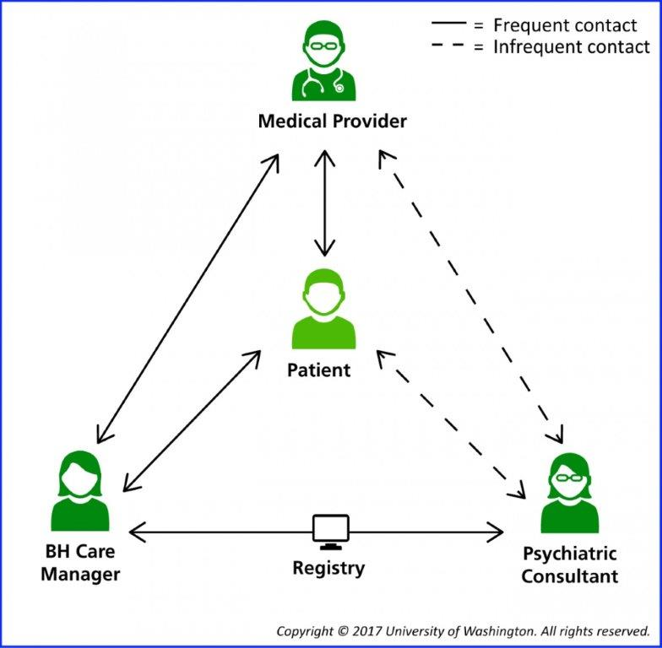
Or you could use….Collaborative Care Codes

Slide 15
99492 Initial Psychiatric Collaborative Care Management
70 minutes in the first calendar month
Outreach to and engagement in treatment of a patient
Initial assessment of the patient using validated rating scales
Development of an individualized treatment plan
Psychiatric consultant review & modifications

Slide 16
99492
Initial Psychiatric Collaborative Care Management - continued
70 minutes in the first calendar month
Registry for tracking patient follow-up and progress with appropriate documentation
Weekly caseload consultation with the psychiatric consultant
Brief interventions using evidence-based techniques
Such as behavioral activation, motivational interviewing, and other focused treatment strategies.

Slide 17
99493 Subsequent psychiatric collaborative care management
First 60 minutes in a subsequent month of behavioral health care manager activities.
Must include:
Tracking patient follow-up and progress
Weekly caseload review with psychiatric consultant
Coordination with PCP and any other treating provider
Psychiatric consultant review & modifications

Slide 18
99493 Subsequent psychiatric collaborative care management
First 60 minutes in a subsequent month of behavioral health care manager activities.
Must include(continued):
Brief interventions using evidence based treatments
Monitoring of patient outcomes using validated rating scales
Relapse prevention planning
Preparation for discharge from active treatment

Slide 19
99494 (originally G0504) Additional psychiatric collaborative care management
Each additional 30 minutes in a calendar month of behavioral health care manager activities listed above.
Listed separately and used in conjunction with 99492 and 99493

Slide 20
Blue Cross Blue Shield of Rhode Island policy for “Behavioral Health Integration Services” 2/20/18
https://www.bcbsri.com/sites/default/files/polices/2018%20Behavioral%20Health%20Integration%20Services.pdf
Job description for the behavioral health care manager demonstrating a collaborative integrated relationship with the team - with formalized training or specialized education in behavioral health
Plan for identification, outreach and engagement of patients directed by a primary care provider
Initial assessment, including administration of validated scales and resulting in a treatment plan
Evidence of a compact/contract with a psychiatric consultant
Written workflows documenting:
Psychiatric consultation/referral process
Evidence based treatment interventions to be used
Plans for ongoing collaboration and coordination with PCP and any other treating providers;
Relapse prevention planning and preparation for discharge from active treatment.
Demonstrated use of a registry for tracking patient follow up and progress
Evidence of weekly caseload review with psychiatric consultant
Evidence of monitoring of patient outcomes using validated rating scales

Slide 21
Psychiatrist (or Psych NP)
Employed by or contracted to the PCP
Does not necessarily have to be a Medicare provider
Advises regarding:
Diagnosis
Recommendations to improve or adjust treatment
Interactions between behavioral health care and medical care
Facilitate referral for direct psychiatric care when indicated
Can deliver face to face service with patient
Consultation can be delivered remotely

Slide 22
Codes and Times
Behavioral Health Integration Coding Summary
BHI Code | Behavioral Health Care Manager or Clinical Staff Threshold Time | Assumed Billing Practitioner Time | Payment/Pt (Non-Fac) Primary Care Settings | Payment/Pt (Fac) Hospitals and Facilities
CoCM First Month (99492) | 70 minutes per calendar month | 30 min | $142.84 | $90.08
CoCM Subsequent Months (99493) | 60 minutes per calendar month | 26 min | $126.33 | $81.11
Add-On CoCM (Any month) (99494) | Each additional 30 minutes per calendar month | 13 min | $66.04 | $43.43
General BHI (99484) | At least 20 minutes per calendar month | 15 min | $47.73 | $32.30
BHI Initiating Visit (AWV, IPPE, TCM or other qualifying E/M) | N/A | Usual work for the visit code | Usual | Usual

Slide 23
Billing
Billing is by calendar month
Billing can happen any time during month
Once minimum time has been spent on collaborative care
Medical provider must see patients not seen within a year of service
Could be month preceding start of Collaborative Care
Do not need to see patient during ongoing months of Collaborative Care
Co-pay is required, but could be covered by Medigap plan

Slide 24
Implementing the Integrated Care Model - AIMS Center
Lay the foundation
Plan for the Clinical Practice Change
Build your Clinical Skills
Launch your care
Nurture your Care

Slide 25
Bibliography / Reference – Psychiatry Consultation
Raney, Lori E. Integrated Care: Working at the Interface of Primary Care and Behavioral Health. American Psychiatric Publishing. 2015
Robinson, Patricia J., Reiter, Jeffrey T. Behavioral Consultation and Primary Care: A Guide to Integrating Services. Second Edition. Springer International Publishing. 2016
Martini, Richard, et al. Best Principles of Integration of Child Psychiatry into the Pediatric Health Homes. American Academy of Child and Adolescent Psychiatry. Approved by AACAP Council June 2012. www.aacap.org
Goodrich, David E. et al. Mental Health Collaborative Care and Its Role in Primary Care Settings. US National Library of Medicine. NIH. Curr Psychiatry Rep 2013 Aug 15 (8):383
Raney, Lori E. Integrating Primary Care and Behavioral Health: The Role of the Psychiatrist in the Collaborative Care Model. American Journal of Psychiatry. Vol 172, Issue 8, August 2015
Notes:
Continuing education approval now requires that each presentation include five references within the last 5 years.
Please list at least FIVE (5) references for this presentation that are no older than 5 years.
Without these references, your session may NOT be approved for CE credit.

Slide 26
References for Collaborative Care
https://aims.uw.edu/collaborative-care/implementation-guide The AIMS Center. University of Washington Psychiatry and Behavioral Sciences
Frequently Asked Questions about Billing Medicare for Behavioral Health Integration (BHI) Services. March 9, 2017
CMS CoCM Fact Sheet: https://www.cms.gov/Medicare/Medicare-Fee-for-Service-Payment/PhysicianFeeSched/Downloads/Behavioral-Health-Integration-Fact-Sheet.pdf
https://www.cms.gov/Medicare/Medicare-Fee-for-Service-Payment/PhysicianFeeSched/
Behavioral Health Integration Services. CMS. Medicare Learning Network. ICN 909432 May 2017.

Slide 27
Contact
Mary Jean Mork, LCSW
VP for Integrated Programming
Maine Behavioral Healthcare - a member of MaineHealth
morkm@mmc.org
207-662-2490
Presentation offered through the Collaborative Family Healthcare Association
www.cfha.net

