Slide 1
Promoting Integrated Behavioral Health in Pediatrics: Rhode Island Efforts
Moderator: Dr Nelly Burdette
Panelists: Debra Hurwitz, Dr Beth Lange, Swanette Salazar, Linda Cabral
Notes:
Nelly

Slide 2
Overview
Integrated Behavioral Health (IBH) policy in RI
  The Role of the Care Transformation Collaborative of RI (CTC-RI) in promoting IBH in RI
Pediatric Focused IBH Efforts
  Early efforts to build infrastructure
  Specialized Efforts to serve special populations
Looking Ahead
Notes:
Nelly

Slide 3
Workshop Presenters
Moderator:
  Nelly Burdette, PsyD
    Senior Director of Integrated Care, CTC-RI
    Director, Population Behavioral Health, Boston Medical Center (BMC)
Panelists:
  Debra Hurwitz, Executive Director, CTC-RI
  Elizabeth Lange, MD Waterman Pediatrics
  Swanette Salazar, Community Health Worker
  Linda Cabral, Senior Program Manager, CTC-RI
Has no real or apparent
conflicts of interest to report.
Notes:
Nelly

Slide 4
Session Objectives
Describe the value of delivering integrated behavioral health services in pediatric practices
Identify the core elements of successful pediatric integrated behavioral health initiatives in Rhode Island
Understand the policy and systems-level support needed to successfully implement integrated behavioral health services
Notes:
Nelly

Slide 5
Who is CTC-RI?
Public-private collaborative co-convened by EOHHS (Medicaid) and Office of the Health Insurance Commissioner
Leader of practice transformation efforts
  Patient Centered Medical Home Accreditation
  Community Health Teams
  Integrated Behavioral Health
Notes:
Deb

Slide 6
CTC-RI Overview
Vision: Rhode Islanders enjoy excellent health and quality of life.
Mission: To lead the transformation of primary care in Rhode Island in the context of an integrated healthcare system; and to improve the quality of life, the patient experience of care, the affordability of care, and the health of populations we serve.
Approach: CTC-RI brings together key stakeholders to implement, evaluate, refine and spread models to deliver, pay for, and sustain high quality comprehensive primary care.
Notes:
Deb

Slide 7
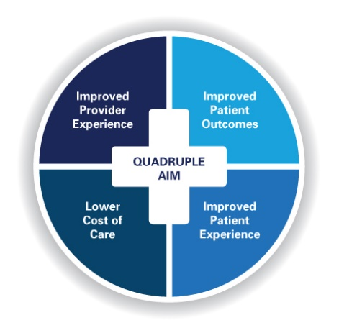
Major Initiatives
Our multi-payer table is uniquely situated to bring together key stakeholders who will select, test and evaluate innovative clinical strategies to build the capacity of the care teams to meet the needs of children, adults and families living in our communities.
Patient Centered Medical Home
  Adult and Pediatric
  Comprehensive Primary Care Capitation
Integrated Behavioral Health
Community Health Teams
Notes:
Deb

Slide 8
Notes:
Deb

Slide 9
Policy Support for IBH in RI
Affordability Standards
Legislation enacted 2006, regulations promulgated 2008-2010
    Office of Health Insurance Commissioner (OHIC)
    1% yearly increase primary care spend (commercial insurers)
    Support statewide multi-payer PCMH transformation
Revised 2014 and 2020 – primary care spend increased from 6.3% to 10.7%
    Add focus on community health teams, now also IBH
Updated standards require new investments in pediatric community based BH
Notes:
Deb

Slide 10
Unmet Need
  14.5% of RI youth experienced at least one major depressive episode in 2022*
  65% of youth with major depression did not receive mental health services (RI rank: 39)*
  In the U.S., most patients with mental health needs rely solely on their PCP.
  Primary care / behavioral health staff have little training in providing integrated behavioral health services in primary care.
*Mental Health America, 2022
Notes:
Deb

Slide 11
Kicking off Pediatric IBH Work
Pediatric-IBH programs included: Cohort 1 (2019-2021) and Cohort 2 (2020-2022)
  8 practice sites:
    2 hospital outpatient clinics, 2 FQHCs, 4 community-based outpatient pediatric primary care sites
Funding from Health Plans and RI Foundation
Notes:
Deb

Slide 12
Building Pediatric IBH Infrastructure
  Onsite IBH Practice Facilitation: support culture change, workflows, billing
  Universal Screening: pediatric relevant screening measures
  Embedded IBH Clinician: warm hand-offs, pre-visit planning, huddles
  PDSA Cycles: screening, registry
  Learning Collaborative and Quarterly Meetings: data-driven improvement, content experts
Notes:
Deb

Slide 13
Better Care – Lower Costs
IBH Cohorts - CTC Non-IBH
Difference of the Differences
∆ $47pmpm – Cohort 1
∆ $43pmpm – Cohort 2
Data Source: Rhode Island All-Payer Claims Database
Notes:
Deb

Slide 14
Emergency Department Visits
Risk-Adjusted (Visits per 1,000 Member-Years Count)
Data Source: Rhode Island All-Payer Claims Database
Notes:
Deb

Slide 15
Pediatric IBH Screening Rates (8 sites)
%
Notes:
Deb or Beth

Slide 16
Depressed patient refused treatment for years. After meeting the IBH provider, patient started treatment:
  “And I had been trying to do that for a very long time. And ‑-‑I just couldn't do it. I mean I just could not get her into counseling. I couldn't get her over the barrier, and she never referred to talking to [our IBH clinician] as counseling. She was just talking to [Name].”
  - Medical Provider
Notes:
Beth

Slide 17
“So, I think every practice should have that (onsite clinician.) Every patient and family should have access to that kind of support in the moment when we’re courageous enough to say, ‘We need help’.…And the payoff may not be to you, insurance company, your foundations; but it’s going to be a payoff to society at large. And that’s really, really important.”
- Medical provider
Notes:
Beth

Slide 18
Resources in RI
PediPRN
MomsPRN
RIPIN
Access Center at Bradley Hospital
Notes:
Beth

Slide 19
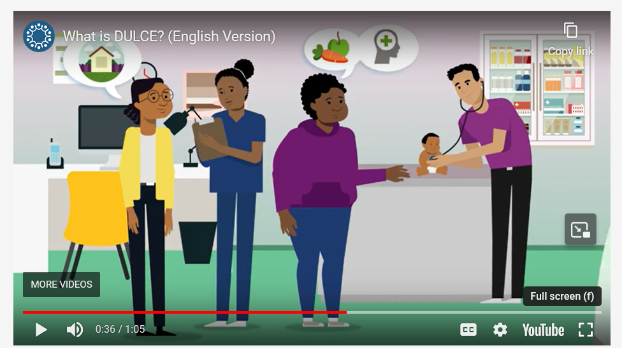
DULCE
Developmental Understanding and Legal Collaboration for Everyone
This project utilizes CHWs to develop trusting relationships with families, screen for social determinants and behavioral health needs, and link families to community and legal resources.
https://www.youtube.com/watch?v=FqL_wntsmSE
Notes:
Swanette

Slide 20
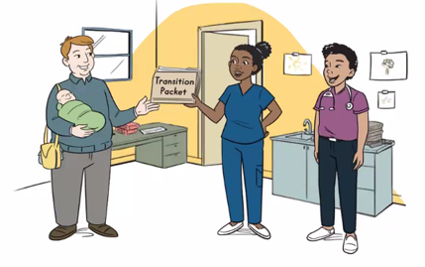
What does the CHW do?
Meets with families at clinic visits and accompanies them in the exam room to provided support
Acts as support between medical visits
Screens for health-related social needs and provides resources for identified needs
Uses relational strategies from Brazelton Touchpoints model and Newborn Behavioral Observation to provide parenting support and anticipatory guidance

Slide 21
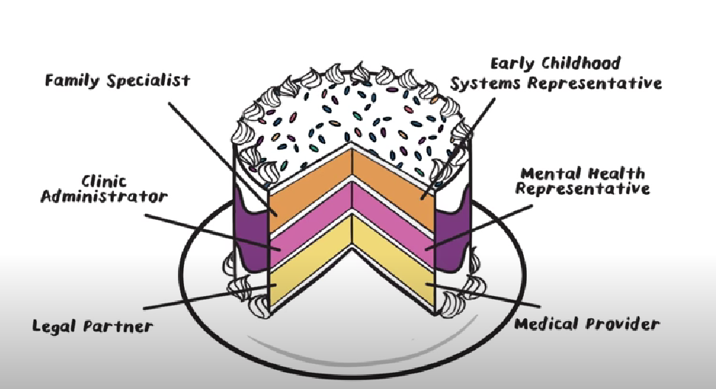
DULCE Ingredients

Slide 22
Pediatric weight management
ECHO© series
IBH Focus
7 practices
participating
1. Epidemiology of Obesity
2. Weight Bias/Stigma
3. Cultural Considerations
4. Prevention / Developmental issues
5. Motivational Interviewing/Difficult conversations
6. Family-Based Behavioral Treatment
7. Empowering Parents
8. Nutrition / Physical Activity counseling
9. Role of IBH clinician / PEDIPRN / Triage Care
10. Self-Monitoring, Engagement in Treatment
11. and 12. Practice Sharing of patient success stories
Notes:
Linda

Slide 23
Clinicians gain skills and confidence
What is your current level of confidence on these items? (5 point scale) | PRE Mean | POST Mean
What is your overall confidence in effectively addressing weight management for children who are overweight / obese? | 3 | 4
The epidemiology and determinants of pediatric obesity and AAP guidelines for best practices | 3.07 | 4.22
Defining weight stigma and bias, and understanding its impact on patient experience and outcomes | 3.2 | 4.22
Different ways of approaching difficult conversations with patients/parents; using Motivational Interviewing techniques with families | 3.13 | 4.33
Strategies for empowering parents to play an active role in improving their child's health | 2.8 | 4.22
Notes:
Linda

Slide 24
Panelist Questions
From your perspective, what have been the successes around pediatric IBH in RI?
From your perspective, what have been some challenges around implementing and sustaining pediatric IBH efforts?
In an ideal world, what 1-2 things would make the most impact to expanding pediatric IBH?
Notes:
10 minutes of

Slide 25


Looking Ahead
The Dream vs Reality
“Innovate or Stagnate”

Slide 26
Nelly Burdette: nellyburdette@gmail.com
Linda Cabral: lcabral@ctc-ri.org
Debra Hurwitz: dhurwitz@ctc-ri.org
Swanette Salazar: SalazarSw@familyserviceri.org
Elizabeth Lange: elange@lifespan.org

