Slide 1
Quarterly Steering Committee:
Increasing Pediatric Integrated Behavioral Health Capacity
with Community Health Workers
September 20, 2024
5/12/2022
Care Transformation Collaborative of Rhode Island
‹#›
Prepared by Care Transformation Collaborative of RI

Slide 2
Agenda
Topic | Speaker | Time
Welcome/Introduction | Linda Cabral, CTC-RI | 9:00-9:05am
Practice Updates and PDSA’s | Liz Cantor, CTC-RI Charlotte Vieira, TEAM UP | 9:05-9:30am
Data and Evaluation Review for Y1 | Andrea Chu, Hassenfeld Institute Emily Feinberg, Hassenfeld Institute | 9:30-9:45am
Y2 Upcoming Milestones | All | 9:45-10:00am
Prepared by Care Transformation Collaborative of RI
Notes:
Linda

Slide 3
Thank you to our funding partners
Prepared by Care Transformation Collaborative of RI
Notes:
Linda

Slide 4
Participating Practices
Track 1
Coastal Medical Bald Hill Pediatrics
Coastal Medical Waterman Pediatrics
CCAP
Pediatric Primary Care, Hasbro Children’s Hospital *
Track 3
Family Care Center Care New England Medical Group
Wood River Health
* Track 1+
Prepared by Care Transformation Collaborative of RI
Notes:
Linda

Slide 5
Practice Facilitation Updates: PDSAs
Both Coastal practices
Epic transition continues to impact screening workflows and data collection
CHW works in both practices, had to take a medical leave, so the practices paused over the summer, resuming this month
________________________________________________________
Coastal Medical Bald Hill Pediatrics
Before the pause: practice working on roles and referral pathways; team developed a tracking system for referrals/outcomes; still working on prioritizing BH navigation vs other SDOH needs
Coastal Medical Waterman Pediatrics
Before the pause: CHW was engaged with 16 families on BH Navigation; completed 7 BH screens for a range of patients ages 5-12 referred to IBH
New patient navigator who is working toward CHW certification
Prepared by Care Transformation Collaborative of RI
Notes:
Liz

Slide 6
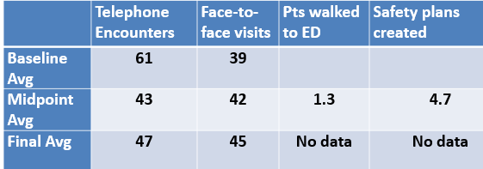
Practice Facilitation Updates: PDSAs
CCAP – focus on expanding screening
1. Expanding ASQ to include 48 months (and ensure 9, 18, 30 mos robust)
Data: By May, 100% for 9, 18, 30 and 48 mos; added ASQ to 36 mo visit
August: 9, 18, 30 mos 79%; 48 mos 81%; 36 mo 80%
2. Positive ASQ Personal/Social Domain -> ASQ SE and WHO to CHW (pilot)
Data: By May, 100% WHO rate, lower SE completion rate (time/schedule); Plan to extend to all providers in the fall
Next up: Rollout the PSC-17 for ages 5-11 – starting with a pilot provider ______________________________________________________________________________________
Hasbro – focus on increasing IBHC capacity to provide clinical services
Overall number of TEs decreased while face-to-face visits
increased; clinic started offering “bridge” appointments
IBHC left – not his preferred model of working
Important lesson learned – now trying to hire new IBHC
Data not available for ED/Safety plans
Prepared by Care Transformation Collaborative of RI
Notes:
Liz

Slide 7
Practice Facilitation Updates: PDSA’s
Wood River
Roll out of PSC-17 for the 4–12-year-old population in progress – began with 1 PCP piloting, increased from 0% patients screened to 23%; expanded to all PCPs in August, utilizing Phreesia functionality to support implementation, data from June-August shows screening rate continued to increase (36%)
Working to codify CHW caseload standards and increase referrals from PCP and BH teams – CHW has maintained ~25 discrete care plans, defined by need, i.e., 1 family = 1 care plan if need is common to family unit vs 2 care plans if 1 child needs school support and 1 needs EI referral
New BH Director working to build capacity and improve workflows amongst BH team
FCC
Working to define new approach to BH screening for adolescents – initially using GAIN-SS for 16-17, transitioning to combination of PHQ-9, GAD-7, and substance use screening
Improving workflows for handoff and triage – steadily working to increase referrals to CHWs
Building infrastructure to enable CHW billing – currently working with EPIC team to finalize CHW documentation templates so that they are compliant with Medicaid billing requirements
Prepared by Care Transformation Collaborative of RI
Notes:
Charlotte

Slide 8
Increasing Pediatric IBH Capacity using Community Health Workers: Baseline Data
September 20, 2024

Slide 9
Project Goal: Increase capacity of pediatric practices to identify and manage behavioral health
Improve Identification of behavior health concerns
Evaluation metric: screening rates
Evaluation metrics:
Warm hand-offs to CHWs
Proportion of CHW encounters that address BH needs vs health related social needs
Adoption and implementation of CHW role
Expand IBH capacity through addition of CHW to IBH team

Slide 10
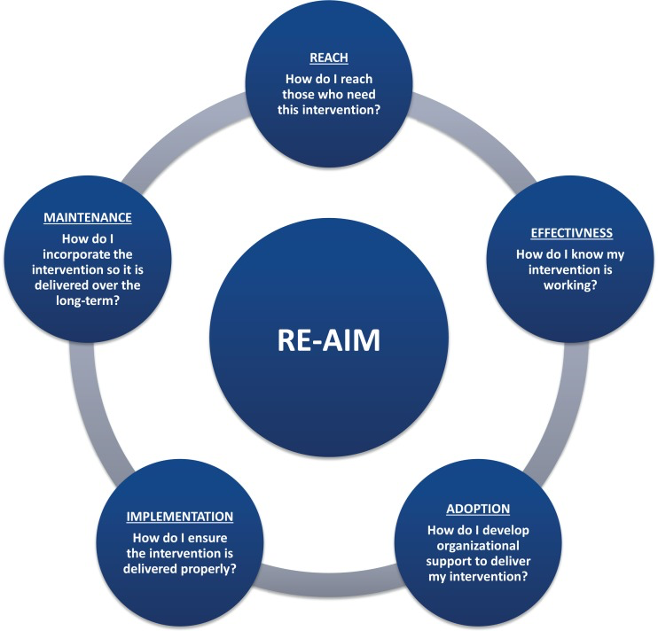
Analytic Framework
# and demographics of children screened
# and demographics children served by CHW
% of CHW encounters with WHO
% of CHW encounters that address BH concerns
Billing for CHW services
Certification of CHWs
Changes to workflows and corresponding barriers and facilitators
Integration readiness surveys
Sites’ understanding of CHW role and needs they meet
ORY, M. G., ALTPETER, M., BELZA, B., HELDUSER, J., ZHANG, C., & SMITH, M. L. (2015). PERCEIVED UTILITY OF THE RE-AIM FRAMEWORK FOR HEALTH PROMOTION/DISEASE PREVENTION INITIATIVES FOR OLDER ADULTS: A CASE STUDY FROM THE U.S. EVIDENCE-BASED DISEASE PREVENTION INITIATIVE.

Slide 11
Screening Rates

Slide 12
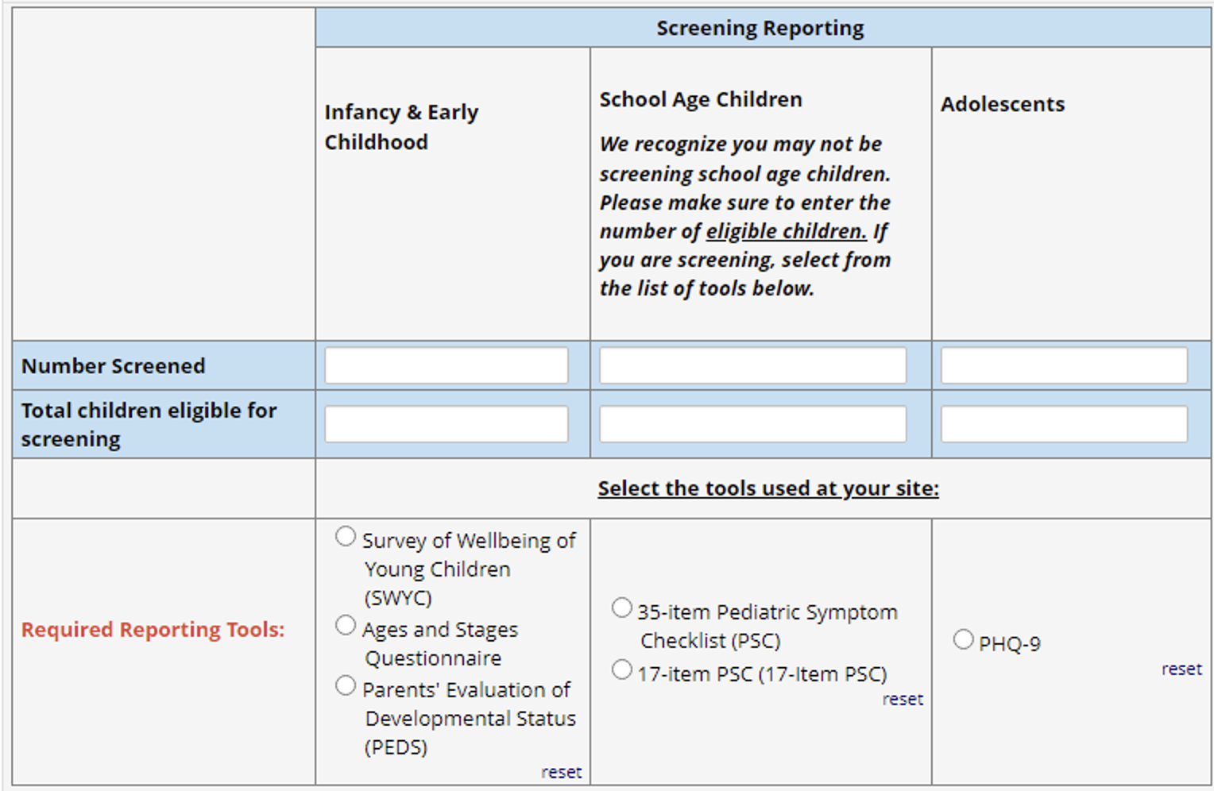

Slide 13
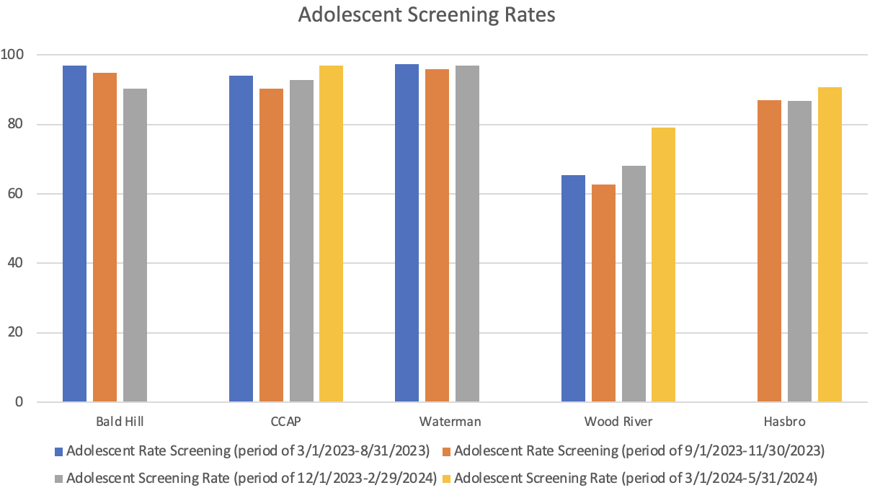
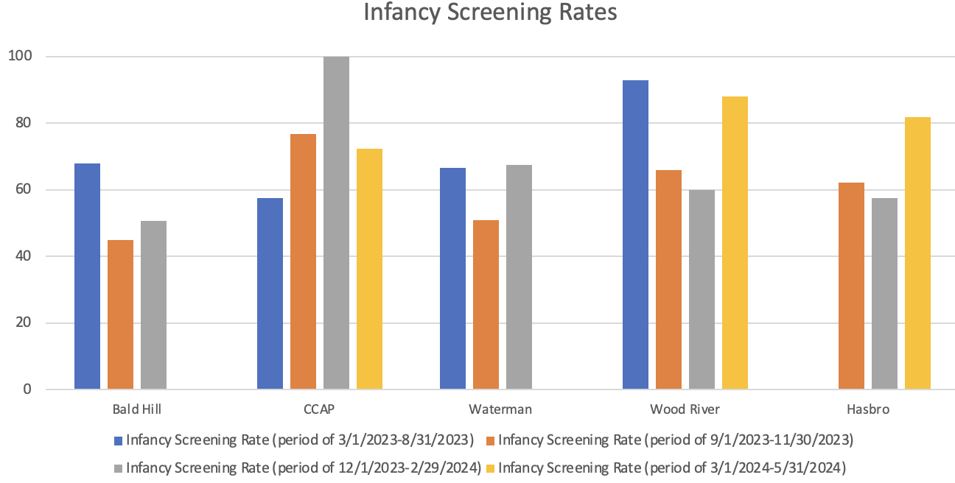
Screening: Reach

Slide 14
Screening: Adoption
“[the sites] have also been leaders in terms of thinking about the universal screening question. Really kind of moving forward with expanding into use of the PSC in that school age population, which we had identified kind of a universal gap across the sites.” - Practice Facilitator
During interviews, core implementation team members recognized the gap in their screening protocols for school-aged kids and endorsed the value of screening all children.
Concerns raised about sites’ capacity to meet the needs of this large group of children and overwhelming limited resources.
School-aged screening is now the focus of PDSAs
“With the increased screenings it's increased [the CHW’s] workload for sure…We had just talked about the importance of delegation.” - Director of IBH

Slide 15
Screening: Implementation
Challenges in expanding school-aged screening included technology and ease of access to screening tools, which initially were not embedded in site EMRs.
“Those poor [site] teams migrating to epic and trying to figure out not only how they were going to use a new EHR, but how the screenings they were doing were no longer possible" -Practice Facilitator

Slide 16
IBH Capacity

Slide 17
CHW Role
CHW patient form used to describe the tasks done by CHWs and how they are spending their time
To be completed for every patient seen during a one-week period, every 3 months
We have 4 data collection timepoints
January 2024
March 2024
June 2024
September 2024

Slide 18
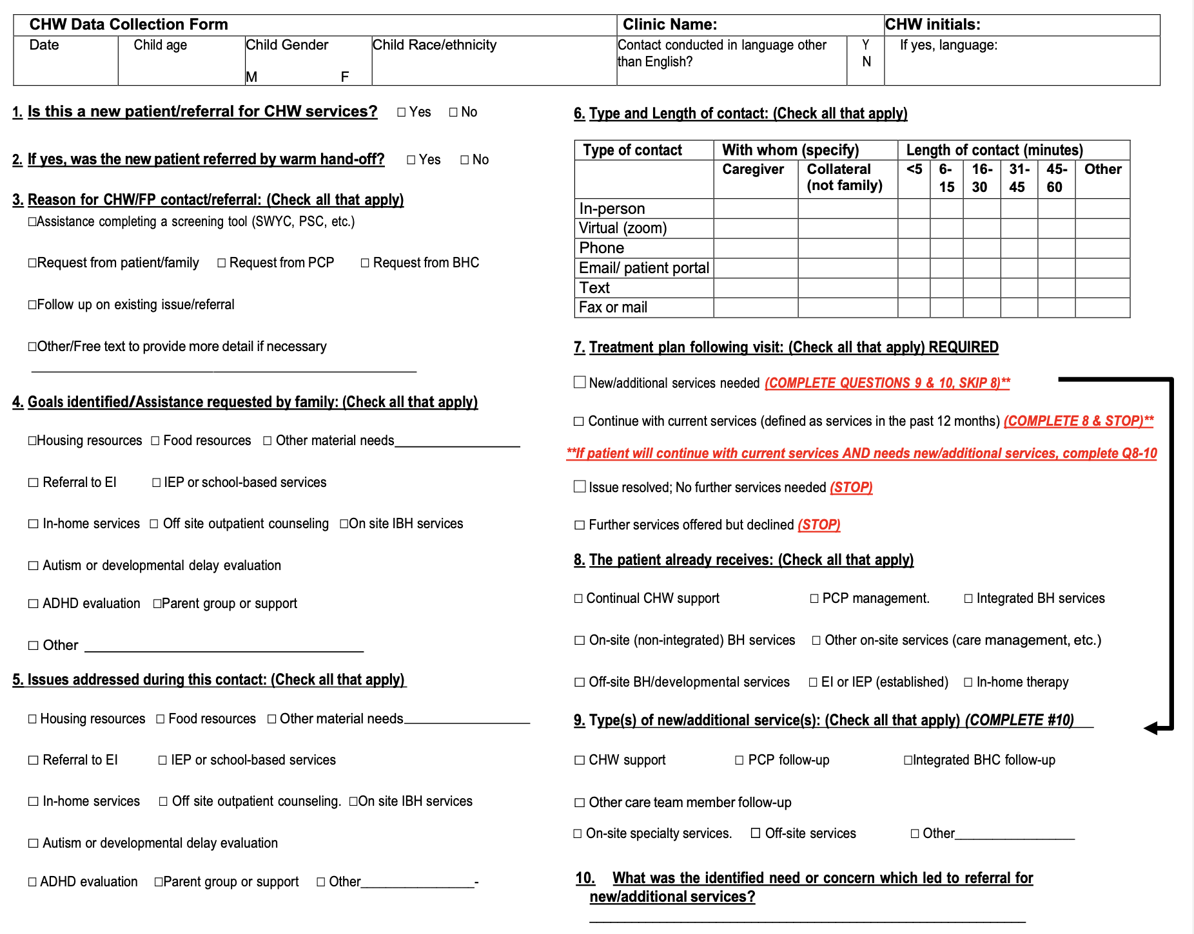

Slide 19
CHW Reach: Patient Demographics (N = 327)
Variable | N | % of Total
Race/Ethnicity Hispanic Non-Hispanic White Non-Hispanic Black Multiple Races Other Unknown/Refused | 120 113 48 7 4 35 | 37% 35% 15% 2% 1% 11%
Gender Male Female Non-Binary | 169 157 1 | 52% 48% <1%
Age 0-5 years 6-11 years 12+ years Not Disclosed | 118 85 121 3 | 36% 26% 37% <1%

Slide 20
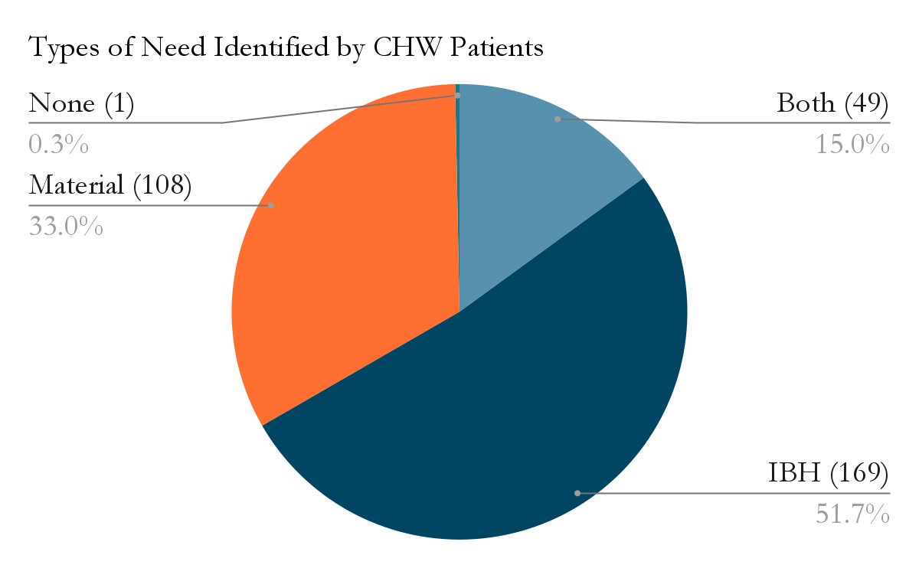
CHW Integration: Effectiveness
“You provide support, validation, encouragement. You provide education, psychoeducation. You provide so much for these families and just the ability to provide that rapport in the initial meeting with somebody in a handoff. And be able to connect them with services and help them to follow through is an admirable skill that you just possess”- IBH Director
Measured as:
proportion of encounters that responded to a BH or developmental concern
proportion of CHW encounters initiated via warm handoffs
Time | Total N | N (%) with Material Needs | N (%) with IBH Needs | N First Encounters | % of First Encounters with a Warm Handoff
Jan 2024 | 63 | 24 (38%) | 47 (75%) | 26 | 89%
March 2024 | 81 | 34 (42%) | 61 (75%) | 38 | 82%
June 2024 | 89 | 54 (61%) | 51 (57%) | 24 | 75%
Sept 2024 | 94 | 45 (48%) | 59 (63%) | 39 | 85%
p-value | – | 0.0246 | 0.0341 | – | 0.6304

Slide 21
% of Patients with the Following Goals Identified or Requested (N = 327)
Type of Goal | Goal Requested | N | % of Total
Material | Food Resources | 48 | 15%
 | Housing Resources | 40 | 12%
 | Transportation | 37 | 11%
 | Other Material Resources | 34 | 10%
 | Insurance | 18 | 6%
 | Diapers | 12 | 4%
 | Cash Assistance | 10 | 3%
Non-Material/IBH | IEP or School-Based Services | 68 | 21%
 | Counselling Services | 67 | 21%
 | Other Non-material Needs | 44 | 13%
 | Parent Group or Support | 29 | 9%
 | In-home Services | 18 | 6%
 | Case Coordination/Referral Support | 14 | 4%
 | Referral to EI | 12 | 4%
 | ADHD Evaluation | 12 | 4%
 | ASD/Developmental Delay Evaluation | 11 | 4%
 | Help Completing Questionnaires/Forms | 10 | 3%

Slide 22
CHW Integration: Adoption
“I was very excited about it [this opportunity]. I think that a lot of what got me so excited about this project is just being able to support these families and advocating and taking the next step. And I think that with the collaboration it provides a unique opportunity…” -CHW
Overwhelming clinical staff buy-in to integrate CHWs into the practice to:
alleviate staffing issues
support families
increase clinicians’ capacity to focus on the provision of clinical care

Slide 23
CHW Integration: Adoption
“We’re curious how other practices are instructing folks on the different roles within the practices… everybody is super excited about the CHW role but they get very easily confused by when do I go to social work, when do I go to the BSW, when do I go to the CHW?” - IBH supervisor
Despite buy-in, staff struggled to understand scope of CHW role and how to define it
uncertain when to use CHWs and how their roles interfaced with other team members
Further training desired on CHW integration
“There are certain individuals even in our system who are having a hard time grappling with the fact that we have a CHW on our IBH team who we are saying they are not as suited to take an SDOH need such as like meeting with a patient to do SSDI forms that would go to SDOH CHW. I think that because we are called community health workers, the doctors, they get confused about the specifics of this role on our IBH team…” -- IBH Director

Slide 24
Case Study
“...One of the providers came to me and said ‘Oh I have this patient’ and she said ‘I don’t know. I feel like I’m missing something…I don’t see mom very [engaged] with the things I’m saying to her about the daughter…can you just go and talk to her to see? Maybe help me out’...So I went, talked to mom. Mom only speaks Spanish…We went to sit down outside…sat in the garden and talking to her you know she told me you know her story. And then by talking she told me that she’s not, you know, able to write or read in any language. I was like oh my god that’s why she was not engaging with the physician, with the doctor, because she couldn’t read all the papers she was given…So after talking to the provider she [the provider] said ‘Oh my god’. She’s been…the doctor for this family for many years… and never knew” -CHW

Slide 25
Case Study
“Sometimes we have moms that come in and don’t know where to go so to speak. They need help navigating—whether it is the healthcare system or the educational system. Um they find that something is not right with their child, but they are not sure or they are too ashamed or it is taboo. Coming from the Hispanic culture, it is unheard of to say depression, anxiety, autism, bipolar disorder. So, these things are now being talked about. And so a lot of times we get families that are afraid to address these things. And so we can talk about that now. And I’m that voice sometimes…even if the provider is you know assisting in that , I can be that other set of hands and be the voice for them to provide that educational piece and to be that shoulder to cry on and to be that support person to say hey there are services available. Let’s work together as a team. We are here for you.” -CHW

Slide 26
CHW Integration: Implementation
Sites struggled to implement CHW role and make corresponding changes to existing workflows:
Triaging appropriate referrals for CHW (SDoH vs IBH)
Space and visibility for CHW
“I do get consistent referrals from um a handful maybe like a couple of the doctors, not all of them.. I haven’t gotten anything from providers since we switched EMRs. We still have to figure out how that, how we want that workflow to go. But they just Teams me if they have a patient that they want to discuss….”- CHW
“In listening to this conversation, I’m having a realization that we should probably have [CHW] and [IBH clinician] actually come to one of our doctor meetings at lunchtime for just 20 minutes and just kind of re-teach us now that you both are in place…” - PCP

Slide 27
Case Study
“We had a conversation regarding a patient that I just visited and there was some miscommunication in the office...I thought that I just had to go straight to the doctor's point person and something [the form] wasn’t completed…I talked to her [the IBH Clinician] and I was like that clearly [the process] wasn’t working, like we need to figure a different way to make sure the patient forms...are like getting completed or I’m getting a message back saying they need extra information... So we figured out a way to you know get the forms directly from the doctor and for me to have that direct connection with the doctor instead of having to go through a middle person. I appreciated that she [the IBH Clinician] advocated for me to be able to have that direct connection with the providers” -CHW

Slide 28
CHW Role: Maintenance
Many sites are currently working toward allowing the CHW services to be billable.
credentialing and approval by compliance is done
Some sites have reported progress towards reaching this goal while others expressed needing more support from upper management.
Challenges include:
Transitions to new EMRs
Lack of IT support
“I will do whatever it takes[to sustain the CHW role], I think this role is essential….we will do whatever it takes grant-wise or system-wise”- IBH supervisor

Slide 29
Key Takeaways

Slide 30
Summary of Findings
Despite initial challenges, sites have implemented workflow changes to fully integrate CHWs and expand IBH capacity
Commitment to expand school-aged screening
Shift from utilizing CHW for only SDoH needs to utilizing them to address IBH needs
CHWs remain an important resource to help families meet critical needs
Increase in warm handoffs
Pursuing CHW reimbursement

Slide 31
Next steps

Slide 32
Next Steps
Continue screening rates and CHW data collection
Conduct midpoint qualitative interviews around January and final interviews in May
Analyze pre and post IBH integration surveys
Prepare final report at end of Y2

Slide 33
Y2 Upcoming Milestones
Milestone | Status
Required Meetings
Learning Collaborative Meetings: Y2 Mid-Point Meeting (Zoom) Wrap-Up Meeting (In person, 4-5PM) CHW meetings with TEAM UP 1-hour Zoom meetings Core Team Based Care Training 8-9 am Zoom meetings with all core team members – PCP, BHC, and CHW CHW Specific Trainings Quarterly, in-person, half-day; January virtual 2-Day IBH Clinician Training In person, in Boston, 9:30-4:30 Optional 1-Day IBH clinician Early In person, in Boston, 9:30-4:30 BHC Case Consultation with TEAM UP Zoom meetings from 10-11am | February 2025 (Tentative) August 7, 2025 1 Completed Monthly from September 2024-August 2025 September 17, 2024, Complete November 6, 2024 January 14, 2025 March 3, 2025 May 7, 2025 October 11, 2024, 9:30 – 1:30 – School Navigation January 10, 2025, 9:30 – 1:30 – CHW Billing April 11, 2025 – 9:30 – 1:30 – TBD July 11, 2025 – 9:30 – 1:30 – TBD October 25, 2024 November 8, 2024 Spring 2025, TBD November 15, 2024 First Tuesday of Every Month
Prepared by Care Transformation Collaborative of RI
Notes:
Linda

Slide 34
Y2 Upcoming Milestones
Milestone | Status
PDSA/Quality Improvement
Implementation of universal BH screening for ages 0-17, with demonstrated improvement against baseline and end-of-year-1 performance Select 1 of the following quality improvement projects Development and piloting of workflow/process mapping for school navigation (this could include navigation to Early Intervention, school-based assessment and services) Development and piloting of workflow/process mapping of warm hand-offs between PCP, IBH Clinician and CHW | Initial plan due Nov 15, 2024 Midpoint due March 31, 2025 Final due Aug 15, 2025
Assessments
Post Assessments AAP Mental health Practice Readiness Inventory Maine Health Access Foundation (MeHAF) Assessment Maslach Burnout Inventory BH Screening Rates Evaluation Interviews with Hassenfeld CHW data collection sheet CHW Questionnaire | May-June 2025 4 data collection timepoints January-February 2025 July-August 2025 5 data collection timepoints Completed once at end of program
Prepared by Care Transformation Collaborative of RI
Notes:
Linda

Slide 35
Next Steps
Practices continue monthly Practice Facilitation meetings
Next Core Team based Training is November 6th
Next CHW Specific Training is October 11th, in person, covering School Navigation
2-Day IBH Clinician Training in person in Boston is on October 25th
Next Steering Committee Meeting – December 20, 2024
Prepared by Care Transformation Collaborative of RI
Notes:
Linda

Slide 36
Funded by RI Executive Office of Health and Human Services (Health Systems Transformation Project (HSTP) and RI Department of Health to:
Prepared by Care Transformation Collaborative of RI

