Slide 1
Community Health Workers in Rhode Island
Date: April 10, 2024
Linda Cabral, Senior Program Manager, CTC-RI
Sarah Lawrence, Executive Director CHWARI
Prepared by Care Transformation Collaborative of RI
Notes:
LINDA

Slide 2
Agenda
Current State of CHWs in RI
CHW Certifications and Trainings

Slide 3
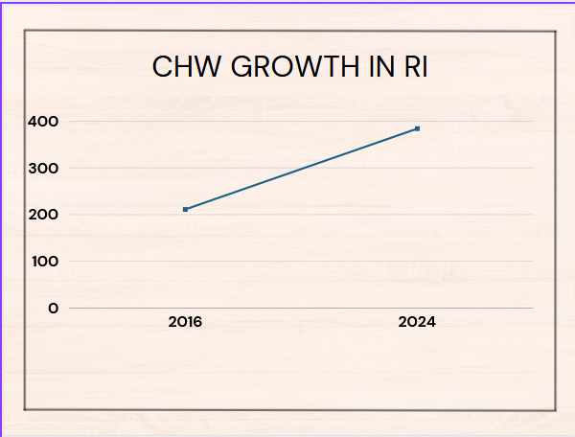
It’s an exciting time to be a CHW in RI!
CHWs play an important role in screening and engagement
Chronic conditions
Behavioral health
(mental health and substance use)
Health Related Social Needs (e.g. housing, food insecurity transportation)
The CHW workforce is growing in RI
RI is one of 24 states having Medicaid coverage of CHW services
CHW Access Act – Federal Bill

Slide 4
CHWs as a Growing Workforce
Sectors employing CHWs
Public Housing
Pharmacies
FQHCs
Schools
HEZs
Refugee Services
Justice Involvement Organizations
Emergency Departments
Child and Family Services
So many others!
CHWs can also be self-employed/independent

Slide 5
Certification of CHWs in Rhode Island
In 2016, the Rhode Island Certification Board (RICB) approved a Community Health Worker Certification structure developed by CHW subject matter experts and other community health stakeholders.
RI’s CHW certification strives to ensure high access, offering a personalized “portfolio” element instead of written exam, and often payment of $125 fee through state funding grants.

Slide 6
Reasons for CHW Certification
Promote professionalization of role, basis of career lattice creation
Provide standards/consistency for both employers’ and CHWs’ sakes
Hiring and retention
Advocacy and better compensation
Transparency/promotion of role for growth of career lattice

Slide 7
RI CHW Certification Requirements
Experience: Six months or 1000 hours of paid or volunteer work experience within last five years
Supervision: 50 hours of on the job supervision
Education: 70 hours of education training relevant to the domains
Portfolio: Supplemental materials according to individual applicant’s experience
Required Recertification: Every 2 years requiring 20 hours of education relevant to the domains

Slide 8
CHW Certification Domains of Competency
Community Health Concepts
Advocacy and Capacity Building
Care Coordination
Health Literacy and Education
Safety and Self-Care
Cultural Competency
Professional Communication and Interpersonal Skills
Ethical Responsibilities and Professionalism

Slide 9
RI Medicaid covers CHW services
Criteria
Medically necessary
Recommended by a licensed practitioner of the healing arts
Health Education and Training
Health Promotion and Coaching
Health System Navigation
Resource Coordination
Collateral Services
Care Planning
Who can provide
Individuals certified by RI Certification Board as CHWs or will be certified within 18 months
An organization can enroll as a CHW provider

Slide 10
More on CHW Billing
17 organizations billing for CHW services
3,000 Medicaid members receiving CHW services
$1.8M paid in CHW claims
Fee-for-service billing (15-minute increments)
No limit to the number of visits/hours allowed per member
No restrictions on place of service
Must enroll as a CHW provider
https://www.riproviderportal.org/
From July 2023-January 2024

Slide 11
Medicare coverage of CHW services
Effective January 1, 2024, the Medicare Physician Fee Schedule established a Community Health Integration service that includes, “person-centered planning, health system coordination, promoting patient self-advocacy, and facilitating access to community-based resources to address unmet social needs that interfere with the practitioner’s diagnosis and treatment of the patient.”
For the first time ever, this Community Health Integration service provision allows Medicare reimbursement for CHWs working under general supervision of a Medicare billing provider.

Slide 12
CHW Training – min 70 hrs for certification
Core CHW Training Providers are:
CHWARI (public)
Community Health Innovations-RI (by employer contract)
Clinica Esperanza (public)
RIPIN (for employees; largest employer of CHWs in state)
Other agencies exploring
Currently 384 Community Health Workers in RI are certified, up from 211 when RICB began certifying in 2016

Slide 13
CHW Endorsements (specialty certifications)
RICB created these with SME assistance in response to expressed need by CHWs. The endorsements aim to expand career opportunities for CHWs and they required a CHW certification before applying:
2018 Specialty in Cardiovascular Health and Diabetes ( 28 certified)
2020 Specialty in Older Adults (13 certified)
2024 Specialty certifications in the works:
Dual Certification CHW/Peer Recovery Specialist (PRS)
CHW Supervisor

Slide 14
Advanced Training for CHWs - CHWARI
CVD/DM | Racial and Social Justice
Older Adults | Public Health
Interpersonal Violence | CHW Supervisor
HIV Endorsement | CHWs and Housing
Oral Health (RIDOH)

Slide 15
Other Advanced Training Providers for CHWs
TRAINING PROVIDER | EXAMPLE TRAINING
Medical Legal Partnership of Boston | Immigration Basics
Rhode Island Parent Information Network (RIPIN) | Public Policy 101
Clinica Esperanza | Vida Sana
Lifespan Community Health Institute | Diabetes Prevention Program
Parent Support Network | Peer Recovery Specialist Training

Slide 16
CHW Workforce Support
There are a growing number of CHW Gatherings and Support Groups:
CHWARI hosts CHW Certification Application Workshops Monthly
CHW Networking Gatherings, examples including:
Independent CHW: Pros and Cons
Bladder Control
Mindfulness
Progreso Latino
CHW Advocacy/Leadership Group
Latinx Support Group, Support Group for Formerly Incarcerated CHWs

Slide 17
Please join CHWARI!
If you are at all interested in this role, join for free to receive our newsletter and announcements weekly.
Consider attending a CHW Networking Gathering – we welcome non CHWs who want to take a look!
Follow us on Facebook and keep checking out our website at www.chwari.org

Slide 18
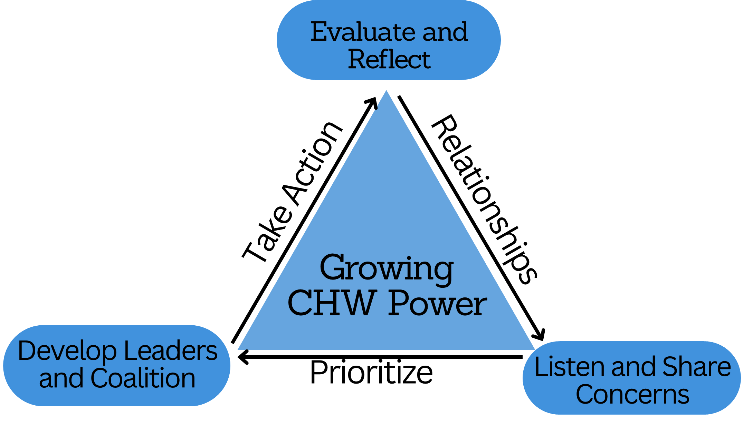
Looking Ahead
Over 100 stakeholders engaged
Statewide CHW Strategy Team developed a 3-5 year statewide CHW Road Map to move from conversations to implementation
Four active implementations teams addressing multiple milestones

Slide 19
