Slide 1
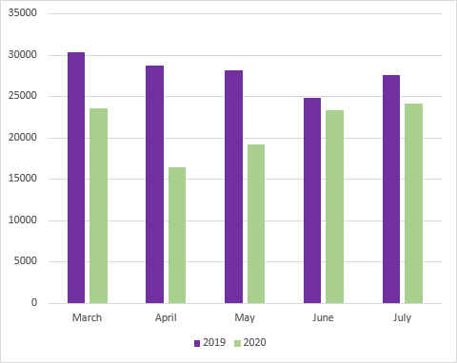
Immunization Doses Administered, post-COVID Decline
- 22%
- 6%
- 13%
Overall 24% fewer vaccine doses were given in March to July 2020 compared to the same time period in 2019
- 32%
- 43%

Slide 2
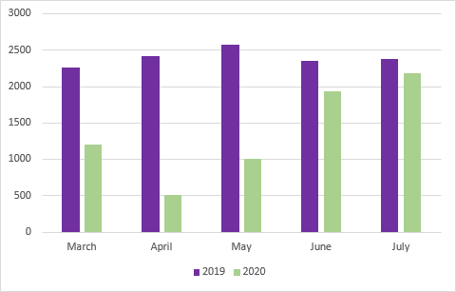
# children lead screened, post-COVID declines
Overall 43% fewer children were screened for lead poisoning in March to July 2020 compared to the same time period in 2019
- 9%
- 18%
- 47%
- 61%
- 79%

Slide 3
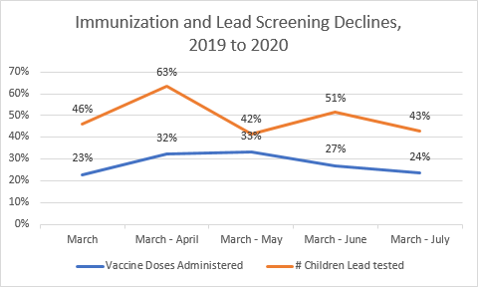
Immunization and Lead Screening, COVID related Declines
When the blue line reaches 0%, then equal numbers of vaccine doses will have been given in 2020 compared to the same time period in 2019
When the red line reaches 0%, then equal numbers of children will have been tested for lead in 2020 compared to the same time period in 2019

Slide 4
Disparities in post-COVID Immunization and Lead Screening declines
Age
The decline in vaccine doses administered is greater for older children (11% decline for age < 2, 36% decline age 2-6, 43% decline age > 7)
The decline in lead screening is greater for children over age 2 (39% decline in age <2, 45% decline for ages 2-7)
Insurance
The decline in vaccine doses administered is greater for publically insured children (25% decline for public insurance, 15% decline for private)
The decline in lead screening is greater for publically insured children (43% decline for public insurance, 38% decline for private)
Ethnicity
The decline in vaccine doses administered is greater for Hispanic children (29% decline for Hispanic, 18% decline for non-Hispanic)
Race
The decline in vaccine doses administered is greatest for Black children (26% decline for Black, 20% decline for White, 21% decline for Asian, 22% decline for other races)

Slide 5
Preventive Healthcare Measures Post COVID
Kindergarten measure: % of children eligible to enter K on 8/31/2020 meeting K immunization requirements, DOBs: 9/1/2014 – 8/31/2015
MMR measure: % of children eligible to enter K on 8/31/2020 having two doses of MMR immunization, DOBs: 9/1/2014 – 8/31/2015
Seventh grade measure: % of children likely to enter 7th grade on 8/31/2020 meeting 7th grade immunization requirements, DOBs: 9/1/2007 – 8/31/2008
Lead Screening measure: % of children between 12 and 24 months of age as of December 31, 2019 with at least one lead screen, DOBs: 1/1/2018 - 12/31/2018

Slide 6
Preventive Healthcare Measures Post COVID
Run Date | # children in K range | # children meeting K immuni-zation require-ments | % in K range meeting K require-ment | # in K range with 2 MMR | % in K range with 2 MMR | # children in 7th grade DOB range | # meeting 7th grade immuni-zation require-ments | % meeting 7th grade immuni-zation require-ment | # children 12-24 mo on 12/31/19 | # with at least one lead screen | % with at least one lead screen
12/31/2019 | 11813 | 9429 | 79.8% | 10109 | 85.6% | 13424 | 8183 | 61.0% | 11074 | 9028 | 81.5%
7/15/2020 | 11892 | 8729 | 73.4% | 9492 | 79.8% | 12996 | 6375 | 49.1% | 10903 | 7988 | 73.3%
8/1/2020 | 11904 | 8851 | 74.4% | 9594 | 80.6% | 13027 | 6551 | 50.3% | 10903 | 8051 | 73.8%
8/15/2020 | 11918 | 8974 | 75.3% | 9693 | 81.3% | 13028 | 6665 | 51.2% | 10892 | 8077 | 74.2%
Source: RIDOH, Center for Health Data and Analysis, KIDSNET
Follow selected age cohorts to track progress
Update 2x per month (1st and 15th)
Compare to similar cohorts in 2019 (the 12/31/2019 row is the baseline for comparison)
Data provided to primary care providers at the practice level

Slide 7
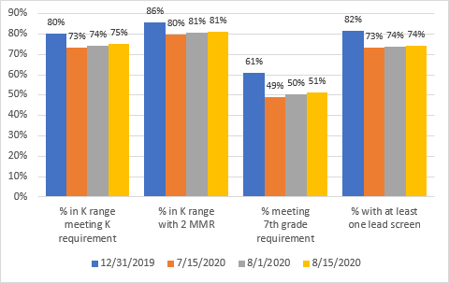
Preventive Healthcare Measures Post COVID
Range among practices with at least 50 patients in the cohort:
K requirements: 44% - 97%
2 MMR: 65% - 99%
7th grade requirements: 11% - 86%
Lead Screening: 36% - 97%
The blue column is the baseline comparison cohort, one year older and as of the end of 2019

